Slide 1
Gathering the companies
Keywords
bitcoin, crypto, blockchain, web3, NFT, smart contract
LinkedIn
Data set on all potential crypto companies
feed keywords
retrieve
clean manually
Data set on all crypto companies
Commercial registry
Data set on all crypto companies incl. founding date
Retrieving the founding dates
feed names
retrieve
aggregate the data
Adding macroeconomic variables
Aggregated time series data set
Federal Statistical Office
Aggregated time series data set with macroeconomic variables
feed cantons
retrieve
Data set for analysis
Final data set for analysis

Slide 2



Gathering the companies
Keywords
bitcoin, crypto, blockchain, web3, NFT, smart contract
LinkedIn
Data set on all potential crypto companies
feed keywords
retrieve
clean manually
Data set on all crypto companies
Commercial registry
Data set on all crypto companies incl. founding date
Retrieving the founding dates
feed names
retrieve
aggregate the data
Adding macroeconomic variables
Aggregated time series data set
Federal Statistical Office
Aggregated time series data set with macroeconomic variables
feed cantons
retrieve
Data set for analysis
Final data set for analysis

Slide 3
Gathering the companies
Keywords
bitcoin, crypto, blockchain, web3, NFT, smart contract
LinkedIn
Data set on all potential crypto companies
feed keywords
retrieve
clean manually
Data set on all crypto companies
Commercial registry
Data set on all crypto companies incl. founding date
Retrieving the founding dates
feed names
retrieve
aggregate the data
Adding macroeconomic variables
Aggregated time series data set
Federal Statistical Office
Aggregated time series data set with macroeconomic variables
feed cantons
retrieve
set the treatment variable
Data set for analysis
Final data set for analysis

Slide 4




Gathering the companies
Keywords
bitcoin, crypto, blockchain, web3, NFT, smart contract
LinkedIn
Data set on all potential crypto companies
feed keywords
retrieve
clean manually
Retrieving the founding dates and aggregating the data
Data set on all crypto companies
Commercial registry
Data set on all crypto companies incl. founding date
feed names
retrieve
aggregate the data
Adding macroeconomic variables
Aggregated time series data set
Federal Statistical Office and Federal Tax Administration
Aggregated time series data set with macroeconomic variables
feed cantons
retrieve
set the treatment variable
Master data set
Setting the treatment variable

Slide 5
Gathering the companies
Keywords
bitcoin, crypto, blockchain, web3, NFT, smart contract
LinkedIn
Data set on all potential crypto companies
feed keywords
retrieve
clean manually
Retrieving the founding dates and aggregating the data
Data set on all crypto companies
Zefix
Data set on all crypto companies incl. founding date
feed names
retrieve
aggregate the data
Adding macroeconomic variables
Aggregated time series data set
Federal Statistical Office and Federal Tax Administration
Aggregated time series data set with macroeconomic variables
feed cantons
retrieve
set the treatment variable
Master sample data
Setting the treatment variable

Slide 6
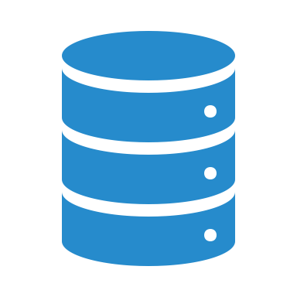
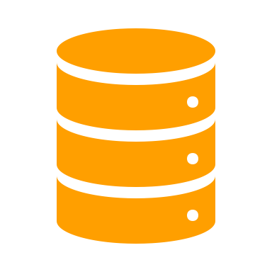
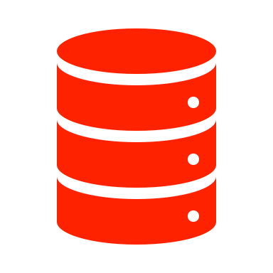
Gathering the companies
Keywords
bitcoin, crypto, blockchain, web3, NFT, smart contract
LinkedIn
Data set on all potential crypto companies
feed keywords
retrieve
clean manually
Retrieving the founding dates and aggregating the data
Data set on all crypto companies
Zefix
Data set on all crypto companies incl. founding date
feed names
retrieve
aggregate the data
Adding macroeconomic variables
Aggregated time series data set
Federal Statistical Office and Federal Tax Administration
Aggregated time series data set with macroeconomic variables
feed cantons
retrieve
set the treatment variable
Master sample data
Setting the treatment variable

